Slide 1
UNIT IV Memory
References:
1. Computer Architecture and Organization by P.Hayes
2. Computer Organisation by Carl Hamacher et. al.
3. Computer Organisation & architecture by William Stallings

Slide 2
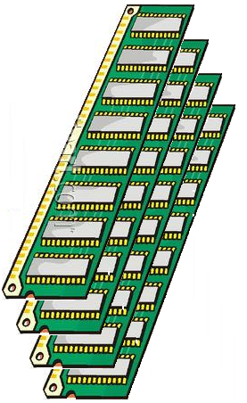
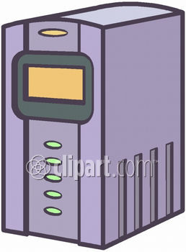
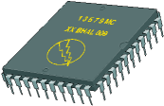
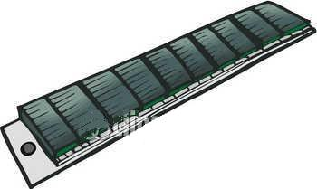


Memory Hierarchy
Main Memory
I/O Processor
CPU
Cache
Magnetic Disks
Magnetic Tapes

Slide 3
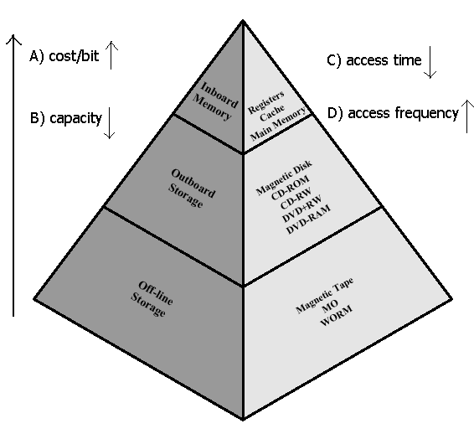

Slide 4
Memory Hierarchy
Major design objective of memory systems
Provision of adequate storage capacity at
an acceptable level of performance
a reasonable cost
Memory technologies
Smaller access time ➔ greater cost/bit
Greater capacity ➔ smaller cost/bit
Greater capacity ➔ greater access time

Slide 5
Access Methods
Sequential Access
Access must be made in a specific linear sequence.
Eg. Magnetic Tape
Direct Access
Involves a shared read-write mechanism.
Eg. Magnetic Disk
Random Access
Any location cn be selected at random and directly addressed and accessed.
Eg. ROM, RAM
Associative
Random access type of memory that enables one to make a comparison of desired bit locations within a word for a specific match. Eg. Cache memory

Slide 6
Performance (1)
Access time
Time between presenting the address and getting the valid data
For random access memory: time to address data unit and perform transfer
For non-random access memory: time to position hardware mechanism at the desired position
Memory Cycle time
Primarily applied to random access memory
Time may be required for the memory to “recover” before next access
Cycle time is (access time + recovery time)

Slide 7
Performance (2)
Transfer Rate: R bps
Rate at which data can be transferred in/out of memory
For random access memory, R = 1/(memory cycle time)
For non-random access memory, T_{N} = T_{A} + N/R, where
T_{N} : average time to R/W N bits
T_{A} : average access time
N : # bits

Slide 8
Physical Types
Semiconductor
RAM
Magnetic
Disk & Tape
Optical
CD & DVD

Slide 9
Performance example (1)
Assume 2-level memory system
Level 1: access time T₁
Level 2: access time T₂
Hit ratio, H: fraction of time a reference can be found in level 1
Average access time, T_{ave} =
prob(found in level1) x T(found in level1) + prob(not found in level1) x T(not found in level1)
= H xT₁ + (1- H ) x (T₁+ T₂ )
=T₁ + (1 - H )T₂

Slide 10
Performance example (2)
Assume 2-level memory system
Level 1: access time T₁ = 1 μs
Level 2: access time T₂ = 10 μs
Hit ratio, H = 95%
Average access time,
T_{ave} = H xT₁ + (1- H )x(T₁+ T₂ ) = .95 x 1 + (1 - .95) X (1 + 10) = .95 + .05 X 11 = 1.5 μs

Slide 11
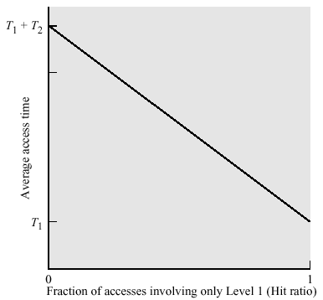
Performance example (3)
Higher hit ratio
➔ better performance

Slide 12
Memory Interfacing
Interface 1KB RAM with a processor using four 256 bytes RAM.
1KB = 1024 x 8 bits
Data bits
Memory locations(Regs)
four 256 will make 1024.
Address lines needed for each = 8(A0-A7), w= 8
memory map RAM1 - x000 – x0ff
RAM2 - x100 – x1ff
RAM3 - x200 – x2ff
RAM4 - x300 – x3ff

Slide 13
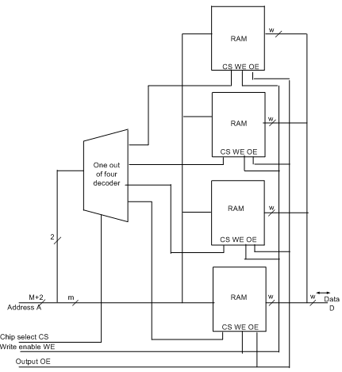

Slide 14
RAM Design
How many 64Mx1bit RAM ICs are needed to make 1GB RAM?
to make 1G(1024 M) 16 ICs are needed.
to get 8 data bits 8ICs are needed in each row.
Thus total ICs needed = 16 x 8 = 128 ICs.
How many address lines needed for each RAM?
Address lines = 26 (2²⁶=64M)

Slide 15
Problem
A 16Mb DRAM chip has a word size W=8 bits and has a 2-D organization with multiplexed row-column addressing.
(a) If the column address is 10bits, what is the size of the row address?
(b)How many copies of this DRAM are needed to make a 1G*32bit memory?

Slide 16
Solution
Given DRAM size = 16Mb, W=8bits
(a)16 Mbit = 2¹ * 2²⁰ * 2³ = 2²¹ * 8bits
Thus total address lines = 21bits
If the column address is 10bits, the size of the row address = 21-10 = 11 bits
(b) need design = 1G * 32 bits = 1024M * 32 bits
Available = 2²¹ * 8bits = 2MB
Total number of DRAM ICs to make 1G * 8bits
= 1024M/ 2M = 512
Total number of DRAM ICs to make 32 data bits(W)
= 32/8 = 4
Thus total number of DRAM Ics needed to make 1G * 32bits
= 512 * 4= 2048 ICs

Slide 17
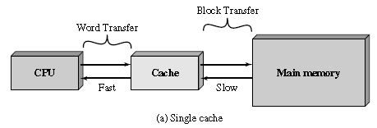
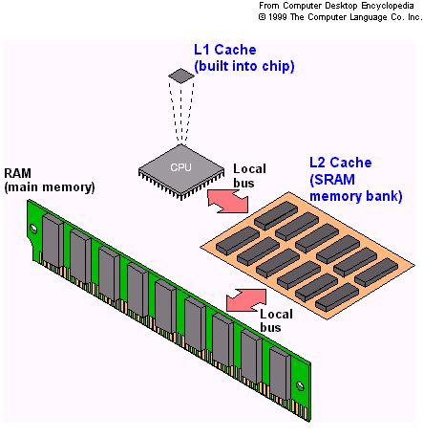
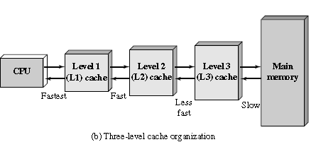
CACHE MEMORY PRINCIPLES

Slide 18
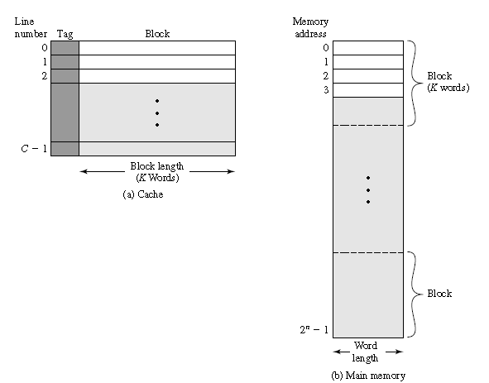
Cache/Main Memory Structure
Main memory consists of up to 2^{n} addressable words, with each word having a unique n-bit address.
For mapping purposes, this memory is considered to consist of a number of fixed length blocks of K words each.
That is, there are M 2n/K blocks in main memory.
The cache consists of m blocks, called lines. Each line contains K words, plus a tag of a few bits.

Slide 19
Cache memory – overview
Cache memory is a memory bank that bridges main memory and the CPU. It is faster than main memory and allows instructions to be executed and data to be read and written at higher speed. Instructions and data are transferred from main memory to the cache in fixed blocks.
When a program executes, the cache memory is searched first, and the referenced word is accessed in the cache if the word is present("cache hit" ).
If the referenced word is not in the cache("cache miss"), then a free location is created in the cache and the referenced word is brought into the cache from the main memory.
The word is then accessed in the cache.
The overall performance can be improved if a high proportion of memory accesses are satisfied by the cache.

Slide 20
General Organization of a Cache
Cache is an array
of sets
Each set contains
one or more lines
Each line holds a
block of data
1 valid bit per line
t tag bits
per line
B = 2^{b} bytes
per cache block
valid
tag
0
1
• • •
B–1
E lines
per set
set 0:
• • •
valid
tag
0
1
• • •
B–1
valid
tag
0
1
• • •
B–1
S = 2^{s} sets
set 1:
• • •
valid
tag
0
1
• • •
B–1
• • •
valid
tag
0
1
• • •
B–1
set S-1:
• • •
valid
tag
0
1
• • •
B–1
Cache size: C = B x E x S data bytes

Slide 21
Addressing Caches
Address A:
t bits
s bits
b bits
m-1
0
v
tag
0
1
• • •
B–1
set 0:
• • •
v
tag
0
1
• • •
B–1
<tag>
<set index>
<block offset>
v
tag
0
1
• • •
B–1
set 1:
• • •
v
tag
0
1
• • •
B–1
• • •
Locate the set based on <set index>
Locate the line in the set based on <tag>
Check that the line is valid
Locate the data in the line based on <block offset>
v
tag
0
1
• • •
B–1
set S-1:
• • •
v
tag
0
1
• • •
B–1

Slide 22
Cache operation – overview
CPU requests contents of memory location
Check cache for this data
If present, get from cache (fast)
If not present, read required block from main memory to cache
Then deliver from cache to CPU
Cache includes tags to identify which block of main memory is in each cache slot

Slide 23
Cache Memory
Cache memory is operated based on locality principle in order to improve performance.
Temporal locality - When a program references a memory location, it is likely to reference that same memory location again soon. i.e. same data item is often reused many times.
- Temporal locality arises because programs spend much of their time in iteration and thus the same section of code is visited a disproportionately large number of times.
Spatial locality - in which a memory location that is near a recently referenced location is more likely to be referenced than a memory location that is farther away. i.e. next instruction to be executed or the next data item to be processed is likely to be the next in line.
- Spatial locality arises because data tends to be stored in contiguous locations.

Slide 24
Types of cache memory
Split Cache –Harvard architecture
Data cache
Instruction cache
Unified cache
Data Cache
CPU
Main Memory
Instruction Cache
Harvard Architecture
CPU
Main Memory
Cache
Unified Architecture

Slide 25
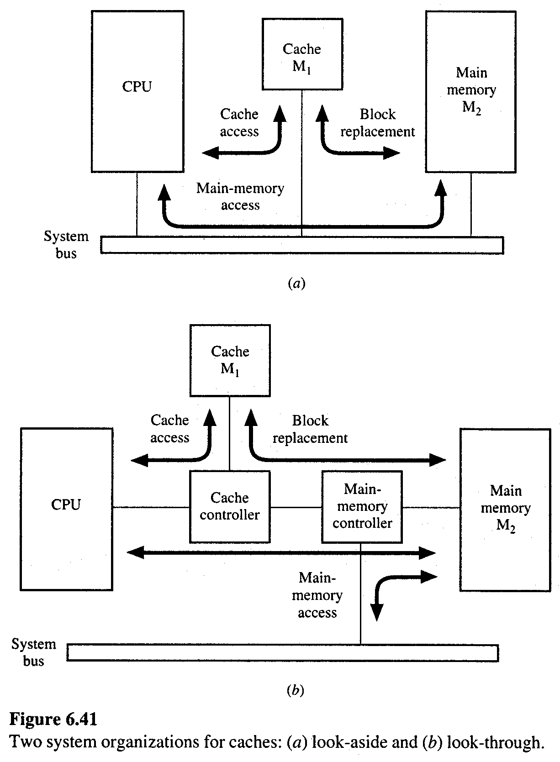
Cache Read
look-aside: the cache and the main memory
are directly connected to the
system bus
look-through: faster, but more expensive
CPU communicates with the cache via a
separate bus.
The system bus is available for use by other
units to communicate with main memory
Only after a cache miss, CPU sends
memory requests to main memory

Slide 26
Cache Write
Write through: The information is written to both the block in the cache and to the block in the lower-level memory.
Write back: The information is written only to the block in the cache. The modified cache block is written to main memory only when it is replaced.
Pros and Cons of each:
– WT: read misses do not need to write back evicted line contents
– WB: no writes of repeated writes
During Write Miss
Write allocate: The block is loaded into cache on a write miss
No-Write allocate: The block is modified in the lower levels of memory but not in cache

Slide 27
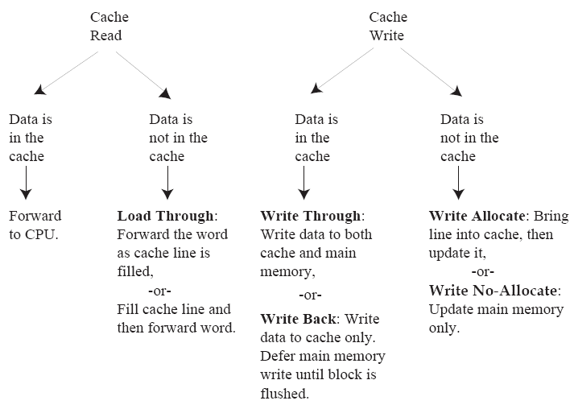
Cache read and write policies

Slide 28
Cache Mapping Schemes
Since there are few cache slots than main memory blocks, an algorithm is needed for mapping main memory blocks into cache slots.
The choice of the mapping function dictates how the cache is organized.
The choice of cache mapping scheme affects cost and performance.
ASSOCIATIVE MAPPED CACHE
DIRECT MAPPED CACHE
SET ASSOCIATIVE MAPPED CACHE

Slide 29
Example for mapping schemes
Main memory size = 4G(2³²)words memory. Assume the memory is divided into 128M(2²⁷) blocks of 2⁵ = 32 words per block, and the cache consists of 2¹⁴ slots.
The main memory is not physically partitioned in this way, but this is the view of main memory that the cache sees.
The cache for this example consists of 2¹⁴ slots into which main memory blocks are placed.

Slide 30
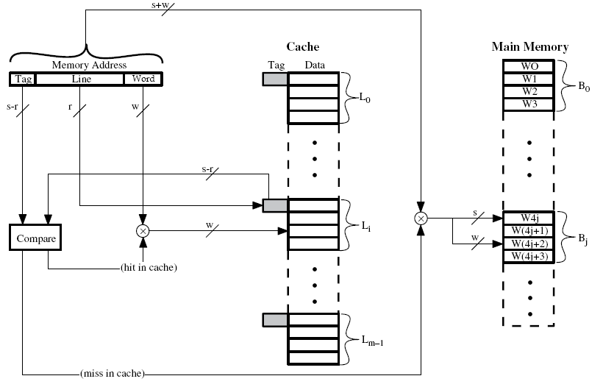
DIRECT MAPPED CACHE
s – to identify the main memory block
w – to identify the word in the memory block m=2^{r} ; No.of lines in cache
r – to identify the line in cache (s-r) - No. of Tag bits

Slide 31
DIRECT MAPPED CACHE
Any one of 2²⁷/2¹⁴ = 2¹³ main memory blocks can be mapped onto cache slot.
In order to keep track of which of the 2¹³ possible blocks is in each slot, a 13-bit tag field is added to each slot which holds an identifier in the range from 0 to 2¹³ – 1.
For a direct mapped cache, each main memory block can be mapped to only one possible slot, but each slot can receive more than one block.

Slide 32
The mapping from main memory blocks to cache slots is performed by partitioning an address into fields for the tag, the slot, and the word as shown below:
The 32-bit main memory address is partitioned into a 13-bit tag field, followed by a 14-bit slot field, followed by a five-bit word field.

Slide 33
Advantages and Disadvantages of DMC
Advantages:
The tag memory in the example above is only 13 x 2¹⁴ bits in size, less than half of the associative mapped cache.
There is no need for an associative search, since the slot field of the main memory address from the CPU is used to “direct” the comparison to the single slot.
Disadvantages:
The cache’s hit ratio drops sharply if two or more frequently used blocks happen to map into the same slot in the cache.
This possibility is minimized by the fact that such blocks are relatively far apart in the memory address space.

Slide 34
Example: Direct-Mapped Cache
Simplest kind of cache, easy to build (only 1 tag compare required per access)
Characterized by exactly one line per set.
set 0:
valid
tag
cache block
E=1 lines per set
set 1:
valid
tag
cache block
• • •
set S-1:
valid
tag
cache block
Cache size: C = B x S data bytes

Slide 35
Accessing Direct-Mapped Caches
Set selection
Use the set index bits to determine the set of interest.
set 0:
valid
tag
cache block
selected set
set 1:
valid
tag
cache block
• • •
set S-1:
valid
tag
cache block
t bits
s bits
b bits
0 0 0 0 1
m-1
tag
set index
block offset
0

Slide 36
Accessing Direct-Mapped Caches
Line matching and word selection
Line matching: Find a valid line in the selected set with a matching tag
Word selection: Then extract the word
=1?
(1) The valid bit must be set
0
1
2
3
4
5
6
7
selected set (i):
1
0110
b₀
b₁
b₂
b₃
(2) The tag bits in the cache line must match the tag bits in the address
= ?
If (1) and (2), then cache hit
t bits
s bits
b bits
0110
i
100
m-1
tag
set index
0
block offset

Slide 37
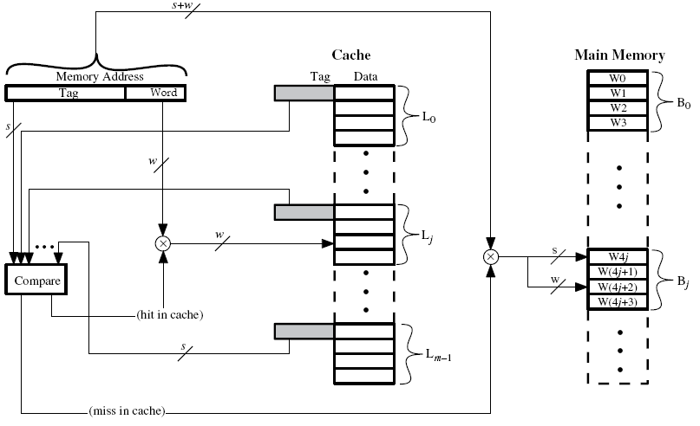
Fully Associative Cache Organization
Tag identifies the memory block

Slide 38
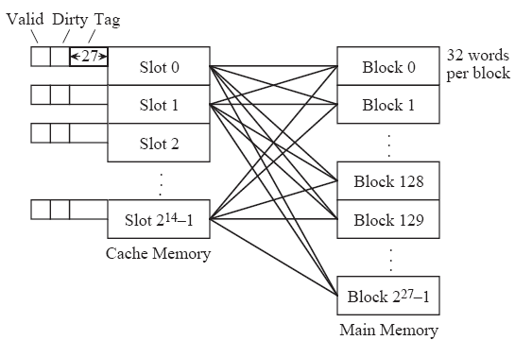
ASSOCIATIVE MAPPED CACHE
In an associative mapped cache, each main memory block can be mapped to any slot. (with only one block placed in a slot at a time).
To keep track of which one of the 2²⁷ possible blocks is in each slot, a 27-bit tag field is added to each slot which holds an identifier in the range from 0 to 2²⁷ – 1.
a valid bit is needed to indicate whether or not the slot holds a block that belongs to the program being executed.
The dirty bit keeps track of whether or not a block has been modified while it is in the cache.
A slot that is modified must be written back to the main memory before the slot is reused for another block.
(Size = 2³² word)

Slide 39
All the tags are stored in a special tag memory where they can be searched in parallel.
Memories that can be searched for their contents, in parallel, are referred to as associative, or content-addressable memories.
Whenever a new block is stored in the cache, its tag is stored in the corresponding tag memory location.
The mapping from main memory blocks to cache slots is performed by partitioning an address into fields for the tag and the word (also known as the “byte” field) as shown below:
Tag identifies the particular block and word identifies the corresponding word(out of 32words) in the block.

Slide 40
Advantages and Disadvantages of AMC
Advantages:
any main memory block can be placed into any cache slot.
Disadvantages:
First, the process of deciding which slot should be freed when a new block is brought into the cache can be complex. This process requires a significant amount of hardware and introduces delays in memory accesses.
Second problem is that when the cache is searched, the tag field of the referenced address must be compared with all 2¹⁴ tag fields in the cache.
Need of associative memory.

Slide 41
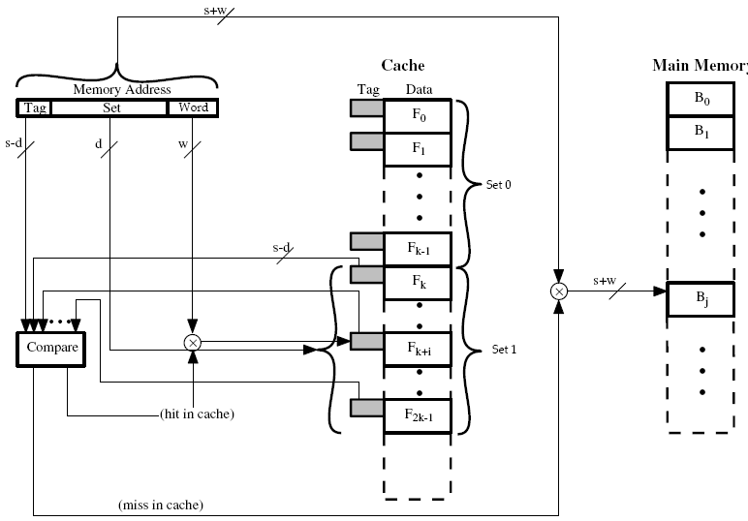
K-Way Set Associative Cache Organization

Slide 42
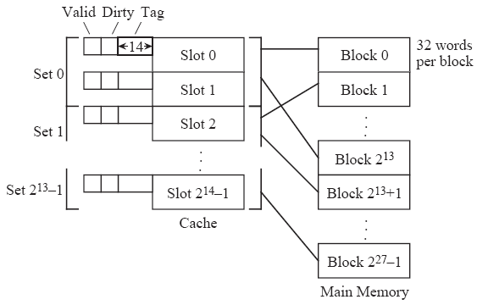

SET ASSOCIATIVE MAPPED CACHE
combines the simplicity of direct mapping with the flexibility of associative mapping.
also known as set-direct mapping.
two slots make up a set, and so it is a two-way set associative cache.
If there are four slots per set, then it is a four-way set associative cache.
Since there are 2¹⁴ slots in the cache, there are 2¹⁴/2 = 2¹³ sets.
When an address is mapped to a set, the direct mapping scheme is used, and then associative mapping is used within a set.

Slide 43
Advantages and Disadvantages of SAMC
Advantages
only two tags need to be searched for each memory reference.
Disadvantages
The tag memory size increases.

Slide 44
Example: Set Associative Cache
Characterized by more than one line per set
set 0:
valid
tag
cache block
E=2
lines per set
valid
tag
cache block
set 1:
valid
tag
cache block
valid
tag
cache block
• • •
valid
tag
cache block
set S-1:
valid
tag
cache block
E-way associative cache

Slide 45
Accessing Set Associative Caches
Set selection
identical to direct-mapped cache
set 0:
valid
tag
cache block
valid
tag
cache block
selected set
set 1:
valid
tag
cache block
valid
tag
cache block
• • •
valid
tag
cache block
set S-1:
valid
tag
cache block
t bits
s bits
b bits
0 0 0 1
m-1
tag
set index
block offset
0

Slide 46
Accessing Set Associative Caches
Line matching and word selection
must compare the tag in each valid line in the selected set.
=1?
(1) The valid bit must be set
0
1
2
3
4
5
6
7
1
1001
selected set (i):
1
0110
b₀
b₁
b₂
b₃
(2) The tag bits in one of the cache lines must match the tag bits in the address
= ?
If (1) and (2), then cache hit
t bits
s bits
b bits
0110
i
100
m-1
tag
set index
0
block offset

Slide 47
Accessing Set Associative Caches
Line matching and word selection
Word selection is the same as in a direct mapped cache
0
1
2
3
4
5
6
7
1
1001
selected set (i):
1
0110
b₀
b₁
b₂
b₃
(3) If cache hit, block offset selects starting byte.
t bits
s bits
b bits
0110
i
100
m-1
tag
set index
0
block offset

Slide 48
Multilevel memory
Consider a two-level hierarchy (M₁ & M₂)
N1: # of address references by M1.
N2: # of address references by M2.
Miss ratio: 1 – H
S_{i}: Storage capacity of M_{i} C_{i}: Cost per bit of M_{i}
For, S₁ << S₂ → C ≈ C₂
Let t_{A1} and t_{A2} the access time of M₁ and M₂, respectively,
t_{A}(access time) = H · t_{A1} + (1-H) · t_{A2}
Let t_{B} : block transfer time, t_{A2} = t_{B} + t_{A1} ∴ t_{A} = H · t_{A1} + (1-H) · (t_{B} + t_{A1}) = t_{A1} + (1-H)t_{B}
Access efficiency
for
For r =100, to make e > 90% → H > 0.998

Slide 49
MEMORY MANAGEMENT Virtual Memory
Method of making main memory appear to have all of the space of the secondary memory.
When a program does not completely fit into the main memory, the parts of it not currently being executed are stored on secondary storage devices such as magnetic disks.
The parts of the program that are going to be executed are first brought into main memory(MM).
When new part of the program is to be moved to MM it must replace another segment(part) already in MM.
OS moves program and data automatically between MM and SM. This technique is called virtual memory technique.
The addresses that the processor issues are called virtual or logical addresses.
A special hardware unit called Memory Management unit(MMU) translates virtual addresses into physical addresses.

Slide 53
Address Translation
Method of translating virtual addresses into physical addresses.
Techniques:
Paging
Segmentation
Paging and Segmentation

Slide 54
Paging
All the programs and data are divided into fixed length units called pages.(Commonly ranges from 2K to 16KB in length).
Each page consists of a block of words that occupy contiguous locations in MM.
An area in MM that can hold one page is called page frame.
Information about MM location of each page is kept in a page table.
This information includes MM address where the page is stored and the current status of the page.
The starting address of the page table is kept in a page table base register.
when a referenced virtual location is not in physical memory, which is referred to as a page fault.

Slide 55
Address translation using paging
p - page number
d – offset
f – disk base address

Slide 56
virtual address is translated into physical address
Address translation using paging
page table

Slide 57
Disadvantage
If pages are too large it is possible that a portion of a page may not be used, yet this unnecessary data will occupy valuable space in MM.

Slide 58
Use of TLB
TLB – Translation Look-aside Buffer
The page table information is used by MMU for every read and write access and it should be placed within MMU.
Since MMU is normally implemented as part of the CPU, it is impossible to include a complete page table(PT) on the chip.
Therefore PT is kept in MM.
A copy of small portion of PT, which has entries that correspond to most recently accessed pages, can be accommodated within MMU.
TLB is a small cache used for this purpose.

Slide 59
Use of TLB in paging
Translation-lookaside buffer (TLB)
Containing (part of ) the memory map
Real base
(block) address B
Virtual base Address
Displacement (offset) D
To memory system

Slide 60
Segmentation
Segmentation divides the address space into segments in variable size.
Segmentation allows for memory protection, so that a segment may be specified as “read only” to prevent changes, or “execute only” to prevent unauthorized copying.
This also protects users from trying to write data into instruction areas.
With segmentation, the user is aware of where segment boundaries are.

Slide 61
Address translation using Segmentation

Slide 62
Address translation using Segmentation

Slide 63
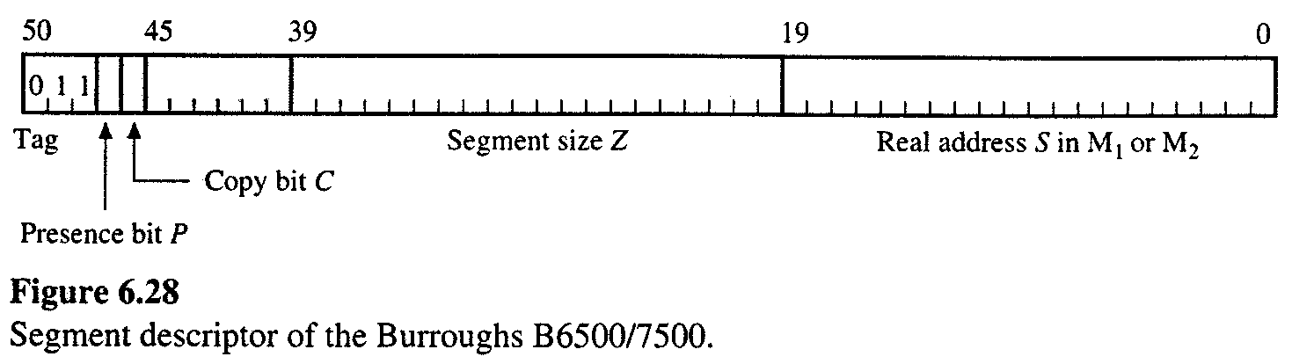
Segment Descriptor of Burroughs B6500/7500
A presence bit P that indicates whether the segment is currently assigned to M₁.
• A copy bit C that specifies whether this is the original ( master ) copy of the descriptor.
• A 20-bit size field Z that specifies the number of words in the segment.
• A 20-bit address field S that is the segment’s real address in M₁ (when P = 1 ) or M₂ ( when P = 0 ).

Slide 64
Segmentation with paging
When segmentation is used with paging, a virtual address has three components: segment index (SI), page index (PI) and a displacement (offset) D.
For fast address translation, two TLB s can be used: one for segment tables and one for page tables.
Every virtual address A_{V} generated by a program goes through a two-stages translation process.
First, the segment index SI is used to read the current segment table to obtain the base addressed PB of the required page table.
The base address is combined with the base index PI(which is just a displacement within the page table) to produce a page address which is then used to access a page table.
The result is a real page address, that is, page frame number which can be combined with the displacement part D of A _{V} to give the final(real) address A _{R}.

Slide 65
Address translation using paging and segmentation

Slide 66
Advantage
This system is very flexible. All the various memory maps can be treated as page segments and can be relocated anywhere in the physical memory space.

Slide 67
Optimal page size on the paged segment
S : memory space overhead due to the paged segment.
,
, where S_{s} : average segment space
S_{p} : page size → impact on storage utilization and memory access rate. too small S_{p} → large page table → reduced utilization.
too big S_{p} → excessive internal fragmentation.
Let u : space utilization factor
Optimum space utilization

Slide 68
Replacement Policies
Four replacement policies that are commonly used are:
least recently used (LRU),
first-in first-out (FIFO),
least frequently used (LFU), and
random.
A fifth policy that is used for analysis purposes only, is optimal.
LRU policy - a time stamp is added to each slot, which is updated when any slot is accessed. When a slot must be freed for a new block, the contents of the least recently used slot, as identified by the age of the corresponding time stamp, are discarded and the new block is written to that slot.
LFU policy - works similarly, except that only one slot is updated at a time by incrementing a frequency counter that is attached to each slot. When a slot is needed for a new block, the least frequently used slot is freed.
FIFO policy - replaces slots in round-robin fashion, one after the next in the order of their physical locations in the cache.
Random replacement policy simply chooses a slot at random.

Slide 69
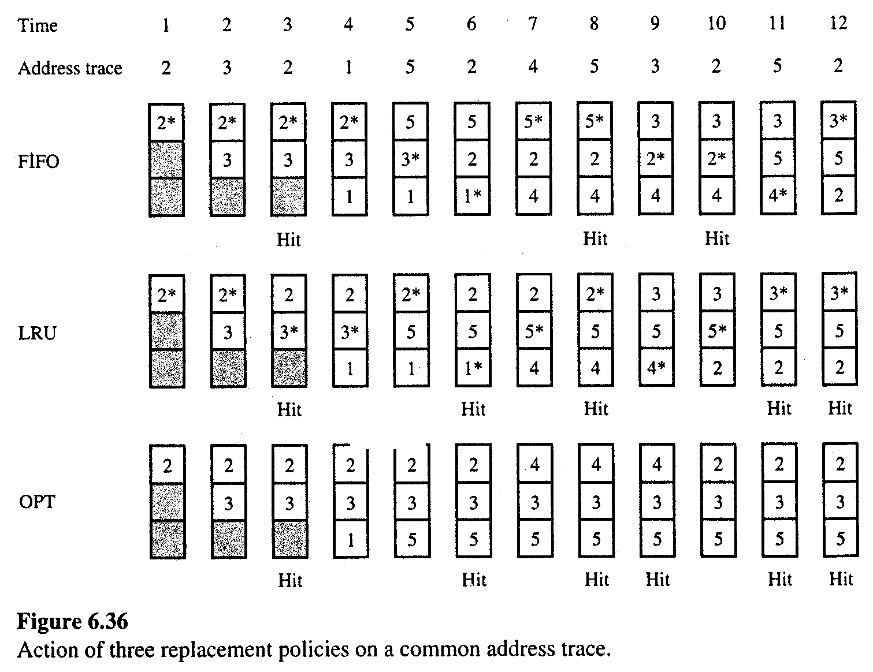
Given Page address stream: 2 3 2 1 5 2 4 5 3 2 5 2

Slide 70
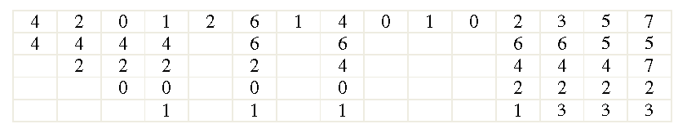
Replacement policy
FIFO
String 4, 2, 0, 1, 2, 6, 1, 4, 0, 1, 0, 2, 3, 5, 7
Page fault by FIFO = 10

Slide 71
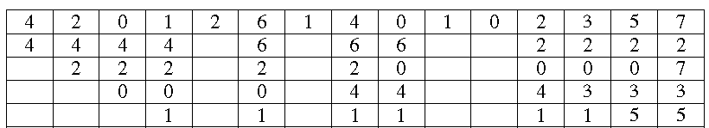
LRU
Page fault by LRU = 11

Slide 72
Memory Protection
Processes should not be able to reference memory locations in another process without permission.
impossible to check absolute addresses in compile time since the program could be relocated. So it must be checked during execution by hardware(processor)
Sharing
allow several processes to access the same portion of memory
better to allow each process access to the same copy of the program rather than have its own separate copy

Slide 73
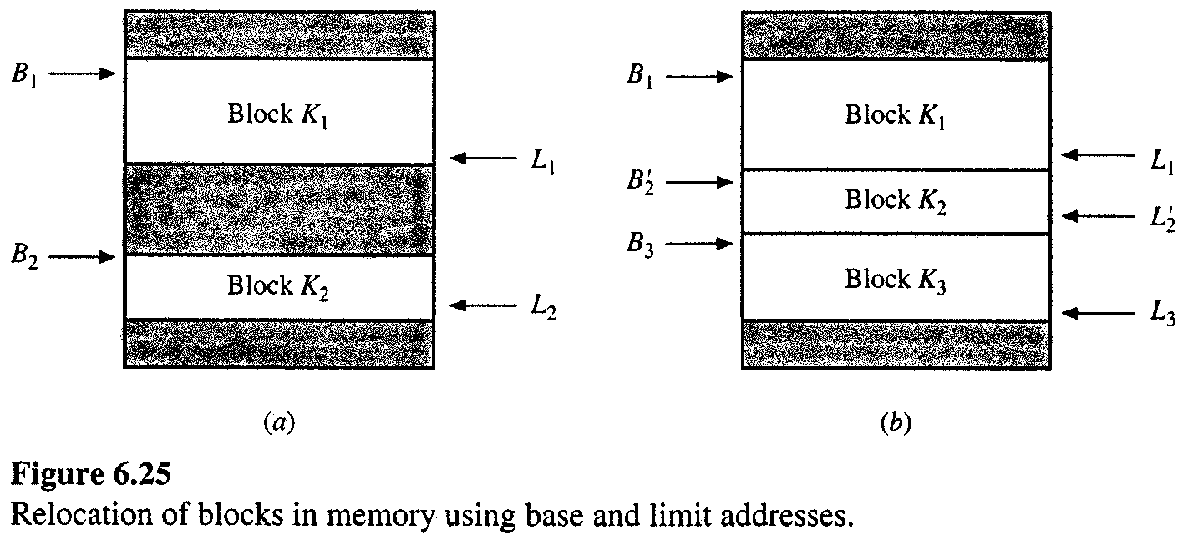
Main memory allocation

Slide 74
Suppose that a block K_{i} of n_{i} words is transferred from secondary to main memory.
• preemptive : if an incoming block can be assigned to a region occupied by another block either by moving or expelling.
• non-preemptive : if an incoming block can be placed only in an unoccupied region that is large enough to accommodate.
① non-preemptive allocation : if none of blocks is preempted by a block K_{i} of n_{i} words, then
→ find an unoccupied “available” region of n_{i} or more words.
→ first fit method and best fit method.
• first–fit method : scans the map sequentially until available region is found, then allocate.
• best–fit method : scans the map sequentially and then K_{i} to a region
n_{j} ≥ n_{i} such that (n_{j} – n_{i}) is minimized.

Slide 75
Example)
Available region address
Size
0
0
0
50
50
50
0 300 800
50 400 200
K₁
K₁
K₁
300
300
300
K₄
K₅
400
550
K₅
650
700
K₂
Two additional blocks K₄: 100 words K₅: 250 words
700
700
800
K₂
K₂
K₄
800
800
900
1000
1000
1000
K₃
K₃
K₃
First fit
Best fit

Slide 76
② preemptive allocation : In non-preemptive allocation, overflow can occur. reallocation for more efficient use
1. The blocks already in M₁can be relocated within M₁ to make a large gap for
the incoming block - Compaction technique
2. Make more available region by deallocating blocks. → how to select the blocks to be replaced. Dirty blocks(modified blocks) : before overwritten, it must be copied into the secondary memory → I/O operation Clean blocks(unmodified blocks) : simply overwrite
Compaction technique : combine into a single block.
K₁
K₁
K₂
Adv: eliminate the problem of selecting an available region. Disadv. : compaction time required.
K₂

Slide 77
Some Questions

Slide 78
A cache has a 95% hit ratio, an access time of 100ns on a cache hit, and an access time of 800ns on a cache miss. Compute the effective access time.
Ans: Teff = .95 × 100ns + .05 × 800ns = 135ns
In direct-mapped cache with a capacity of 16KB and a line length of 32 bytes, how many bits are used to determine the byte that a memory operation references within a cache line, and how many bits are used to select the line in the cache that may contain the data?
Ans: 2⁵ = 32, so 5 bits are required to determine which byte within a cache line is being referenced with 32-byte lines, there are 512 lines in 16KB cache, so, 9 bits are required to select the line that may contains the address (2⁹ = 512).

Slide 79
A set associative cache consists of 64 slots divided into 4-slot sets. Main memory contains 4K blocks of 128 words each. Show the format of the main memory address.
Cache: 64 slots divided into 4-slot sets. i.e. 64/4 = 16 slots in each set.
2⁴ = 16 ➔ 4 bits required to identify the slots in a set.
Main Memory: 4K blocks = 4 x 1024 =4096 blocks (1 block = 128 words= 2⁷ words )
Size = 4096 x 128 = 2¹² .2⁷ = 2¹⁹ = 512K words
Address = 19 bits
Tag = 19-(4+7) = 8 bits
Tag: 8 bits Set: 4 bits Word: 7 bits

Slide 80
A computer has 16 pages of virtual address space but only 4 page frames. Initially the memory is empty. A program references the virtual pages in the order: 0 2 4 5 2 4 3 11 2 10. (a) Which references cause a page fault with the LRU page replacement policy? (b) Which references cause a page fault with the FIFO page replacement policy?
(a) 0, 2, 4, 5, 3, 11, 10
(b) 0, 2, 4, 5, 3, 11, 2, 10

Slide 81
THANK YOU

